Slide 1

CISC-6100:
Software Engineering
Midterm review
Week 7 -- October 18

Slide 2

Outline for today’s class
Review homework
Project demonstration
Review of semester to date
Midterm overview and practice
Project and midterm question time

Slide 3
Homework review
To be completed as a team
Class diagram
Update your project plan to include new details
Breakdown of major task into individual tasks
Assignment of primary contributor to each task
Estimated start and completion dates for each task
Fill in the diagram on the next slide and include the name of the full stack you are using (if any)
Present your team’s full stack decision and your updated project plan

Slide 4
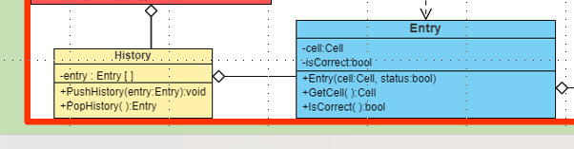
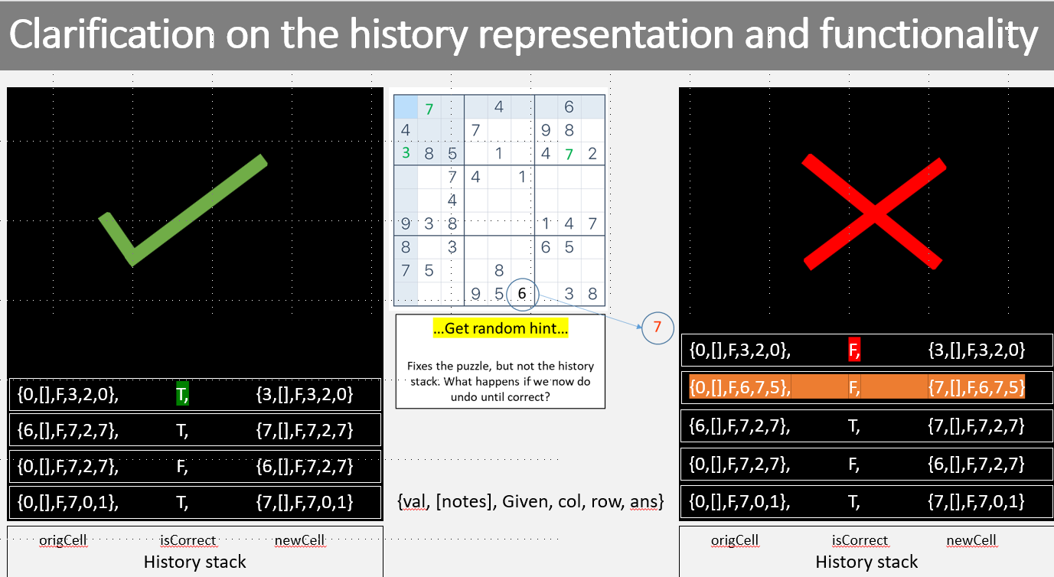
Class Diagrams

Slide 5
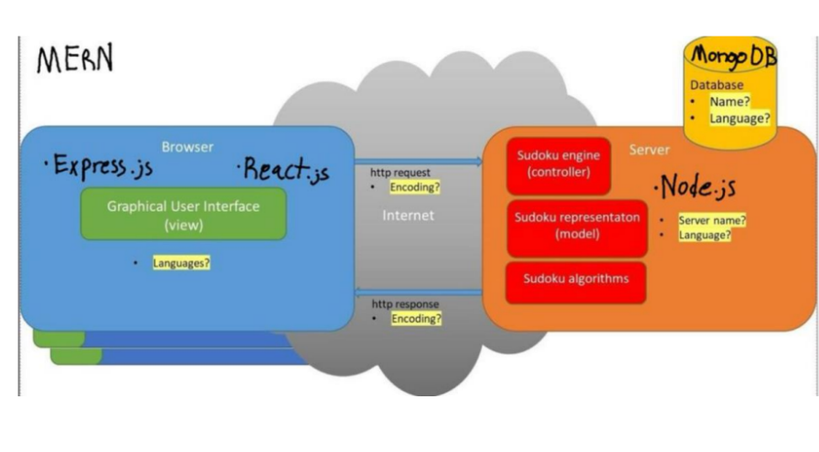
Team Presentations
Team F

Slide 6
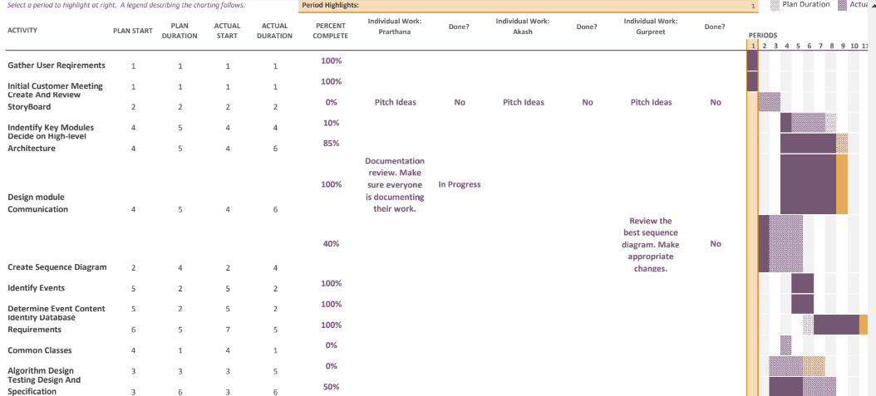
Team Presentations
Team F

Slide 7
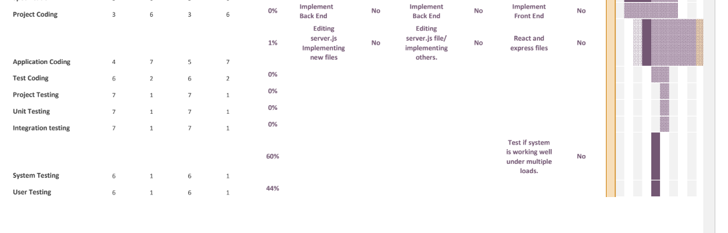
Team Presentations
Team F

Slide 8
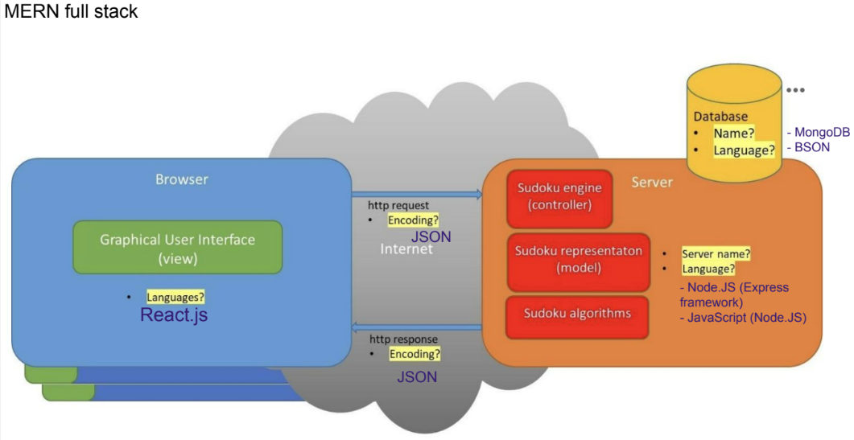
Team Presentations
Team E

Slide 9
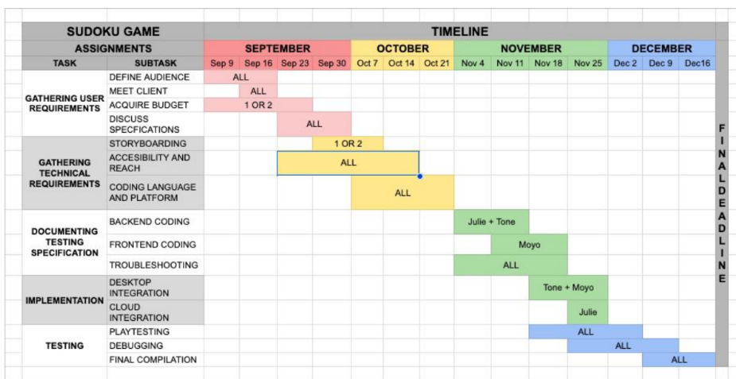
Team Presentations
Team E

Slide 10
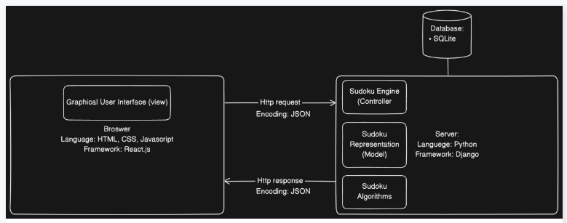
Team Presentations
Team D

Slide 11
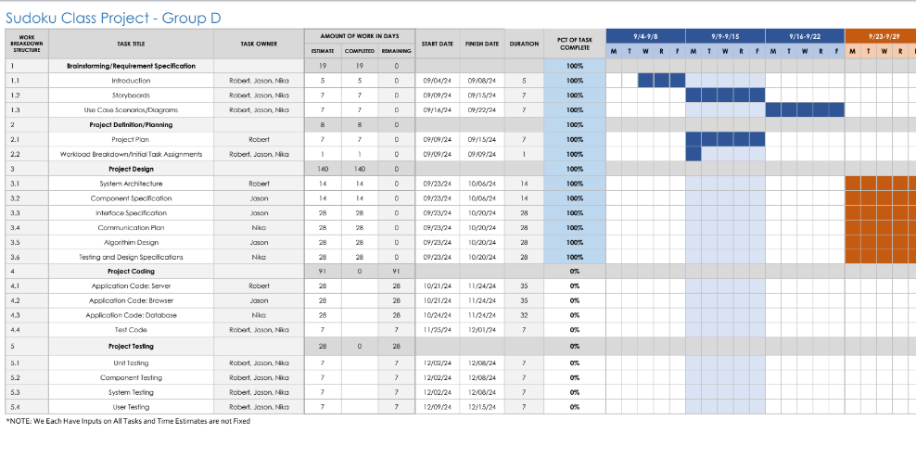
Team Presentations
Team D

Slide 12
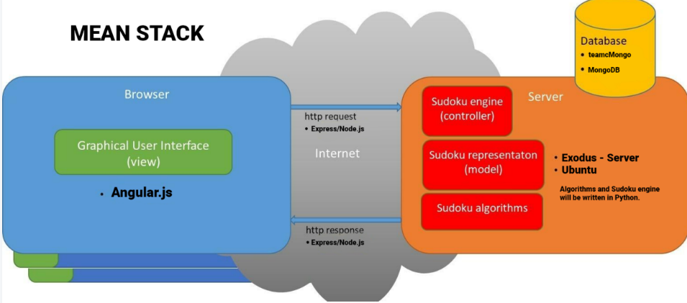
Team Presentations
Team C

Slide 13
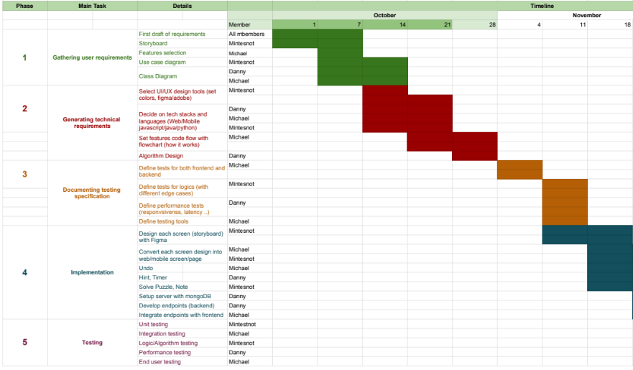
Team Presentations
Team C

Slide 14
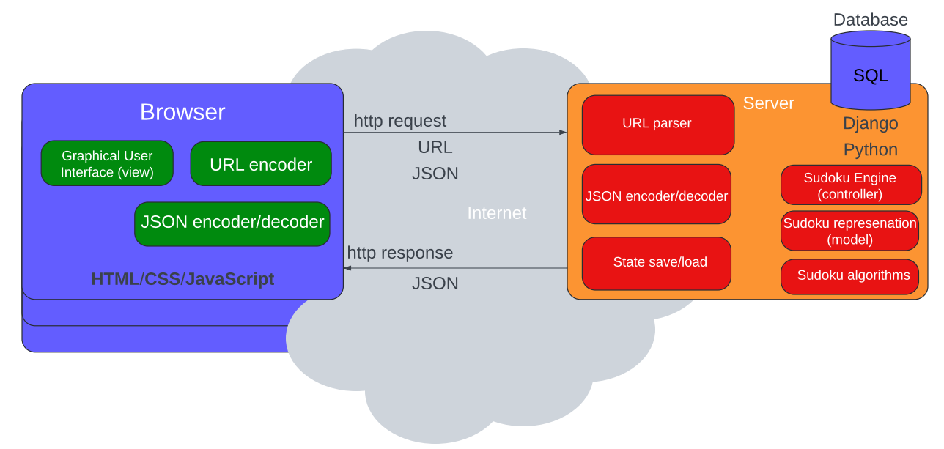
Team Presentations
Team Bro

Slide 15
Team Presentations
Team Bro
See in Excel

Slide 16
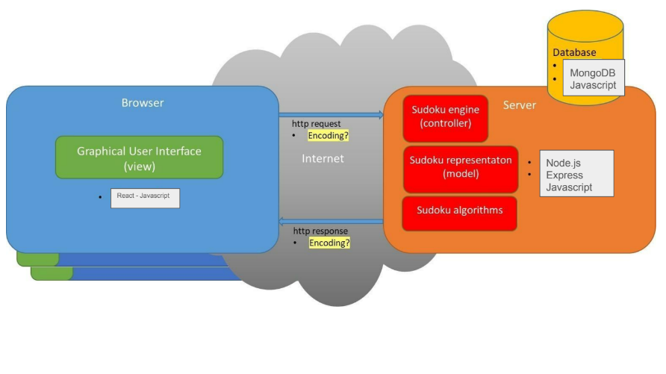
Team Presentations
Team Azerbaijan

Slide 17
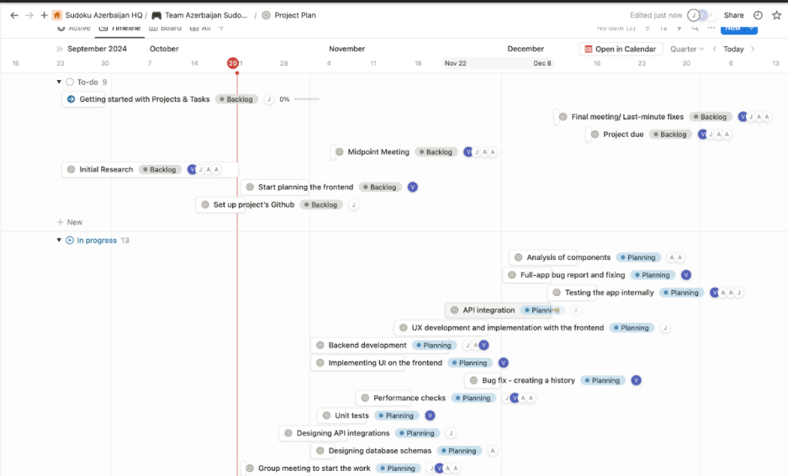
Team Presentations
Team Azerbaijan

Slide 18
Project Demonstration
Synchronous
Asynchronous
Process A
Process A
Call Resource X
Continue process A
Call Resource X
Wait for result
Continue process A
Resource X
Resource X
Handle result from Resource X

Slide 19
Project Demonstration
HTML only screen
HTML code
Full app
CSS code
JavaScript code
Interface (asynchronous)
Request
Response
Server (Django)
Views
Engine
Representations
Second full app
DB model

Slide 20
Review of semester to date

Slide 21
What is software engineering?
It is the application of engineering principles to software development. In contrast to simple programming, software engineering is used for larger and more complex software systems, which are used as critical systems for businesses and organizations.
https://www.techopedia.com/definition/13296/software-engineering

Slide 22
The Software Development Life Cycle (SDLC)
Requirements gathering and analysis
Design
Implementation or coding
Testing and validation
Deployment
Maintenance

Slide 23
Requirements gathering and analysis
Goals:
Understand the critical nature of obtaining and understanding user requirements
Learn various methods to obtain mutually agreed upon user requirements
Understand obtaining user requirements may not be a one-and-done deal
Motivation
The later (new) specifications are made, changes are requested, or errors found, the more timely and costly are the corrections
Analogy from architecture: Building a doghouse versus an office building
Software Error Origin in Resulting costs
Requirements 56% 82%
Design 27% 13%
Implementation 7% 1%
Bug versus error
Fundamentals of Software Engineering, 2nd edition: Carlo Ghezzi, Mehdi Jazayeri, Dino Mandrioli; Prentice Hall 2003

Slide 24
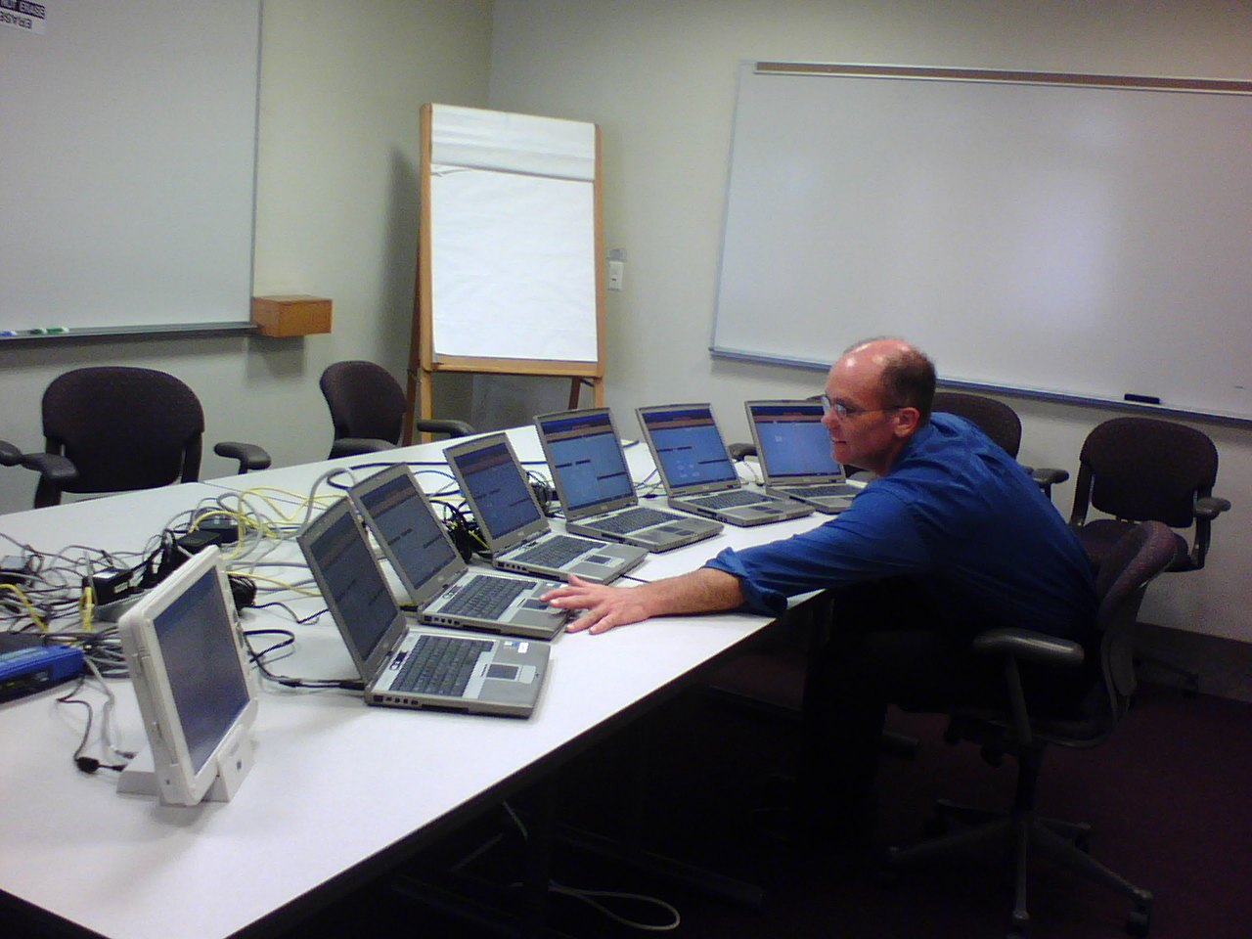
Requirements gathering and analysis
Storyboards
Captures user experience for proposed project.
Easily understood by (non-technical) customers and potential users
Captures “look and feel”
Highly visual

Slide 25
Use case scenario:
Use case scenarios
Captures actions along with expected and non-expected behaviors for all users (actors)
Text based
Context is documented, but not necessarily sequence of events to get there
Lots of information with which to start technical design phase
Elements of a Use Case
Depending on how in depth and complex you want or need to get, use cases describe a combination of the following elements:
Actor – anyone or anything that performs a behavior (who is using the system)
Stakeholder – someone or something with vested interests in the behavior of the system under discussion (SUD)
Primary Actor – stakeholder who initiates an interaction with the system to achieve a goal
Preconditions – what must be true or happen before and after the use case runs.
Triggers – this is the event that causes the use case to be initiated.
Main success scenarios [Basic Flow] – use case in which nothing goes wrong.
Alternative paths [Alternative Flow] – these paths are a variation on the main theme. These exceptions are what happen when things go wrong at the system level.
How To Write a Use Case …
From: https://www.usability.gov/how-to-and-tools/methods/use-cases.html

Slide 26
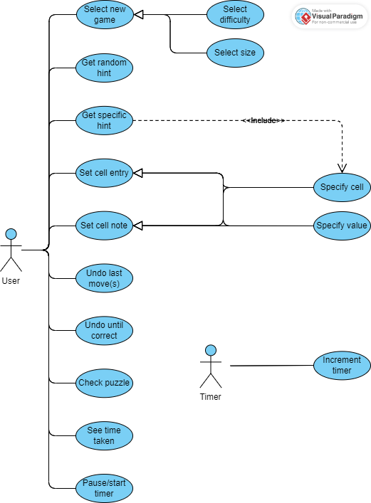
Use case diagram:
Use case diagram
Overview of user actions (for all users and system triggered events)
Concise, but requires training to understand
Good for generating system tests

Slide 27
Requirement gathering and specification comparison
IMHO
Metric | Use Case Scenario | Use Case Diagram | Storyboard | Rapid prototype
Customer understanding | + | - - | + + | ++
Detail | + + | - | + | ++
Programmer understanding | + | + | ++ | ++
Test specification | + | ++ | - | +
Port to implementation | - | - | + | ++
Ease of creation | + + | + | - * | -- **
“Look and Feel” | - | -- | + | ++
* If storyboards are created in a Software Development Kit (SDK), then the effort can be re-used in implementation, saving valuable time
** If prototypes are created with code reuse in mind, they may save in development time

Slide 28
How to gather information about requirements
Your team has been asked to design and implement a video game for pool (billiards). The application will allow for selecting from a menu of different pool games and number of teams/players. For each player’s turn a representation of the cue stick can be manipulated to strike the cue ball in a desired direction and speed. The result of this will be a graphical representation of ball movement, including balls hitting other balls, balls hitting walls, and balls going into pockets. The program will update a display of scores after each shot and declare a winner when according to the rules of the game being played the game is over.
Nouns leading to potential classes / data structures: game, games, player(s), cue stick, cue ball, ball, balls, walls, pockets, score
Verbs leading to potential user generated actions
Verbs leading to potential functions or methods
How to establish requirements:
Customer interviews
Analysis of written descriptions

Slide 29
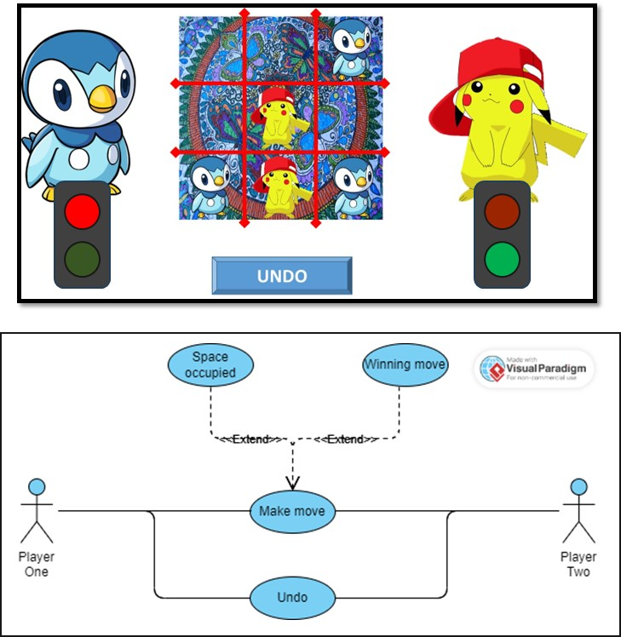
Deriving components (example): use case driven design
Game Begins:
Draw board
Draw players
Create “Undo” button, faded out
Set turn to left-side player
Draw lights
Location selected:
If location selected not already occupied
Put current player’s representation at location selected and record move
If move wins game
Show winning path
Prompt for another game …
Restart or exit
Make “Undo” not faded out
Change turn to other player
If location already selected notify player to select an empty location
Undo selected:
Remove last move from board
Change turn back to previous player
Graphical User Interface
(GUI)
Handle user input
Update user display
Game representation
(Data structures/classes)
Turn
Board
Move history
Game Engine
Legal move?
Make move
Winning move?

Slide 30
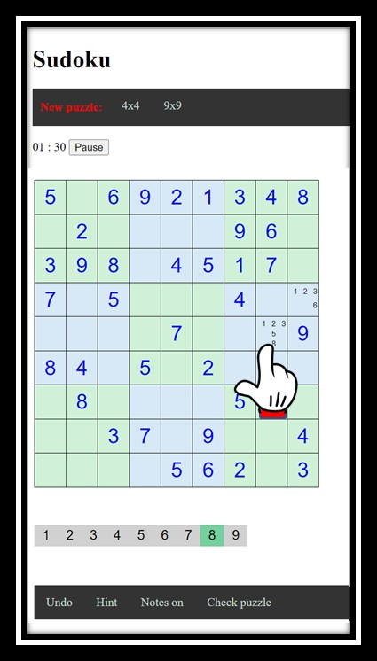
Event tracing:
Start a puzzle from the library
Undo until correct
Get a random hint
Make entry in puzzle
Make note in cell
Start a puzzle of specified size/difficulty
Screen Management
Run-time/long-term
representations
Actor Actions
Event Handlers
Algorithms
MainMenuSelect(…)
RequestHint(…)
DrawPlayScreen(…)
SetValue(…)
CurrentCell
SolvePuzzel(…)
SelectBoardSize(…)
SelectCell(…)
UpdateCell(…)
SetNote(…)
Puzzle
GeneratePuzzel(…)
SelectDifficulty(…)
RequestUndo(…)
UpdatePuzzle(…)
UndoLast(…)
History
RankDifficulty(…)
SelectValue(…)
RequestCheck(…)
UpdateClock(…)
UndoUntilCorrect(…)
ElapsedTime
ToggleNotesMode(…)
ClockTick(…)
DisplayMessage(…)
Hint(…)
Solution
NewPuzzle(…)
PuzzleLibrary(…)
NewPuzzle(…)
Mode
LoadPuzzle(…)
Database

Slide 31
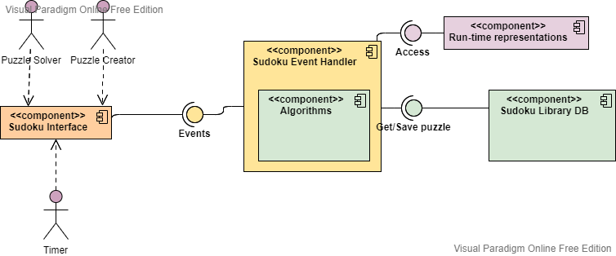
Component diagrams
Help us to:
Divide and conquer
Achieve higher levels of abstraction
Focus on the transfer of information
Build software that exhibits effective modularity
Some of the design principles from our book.
They represent best practices

Slide 32
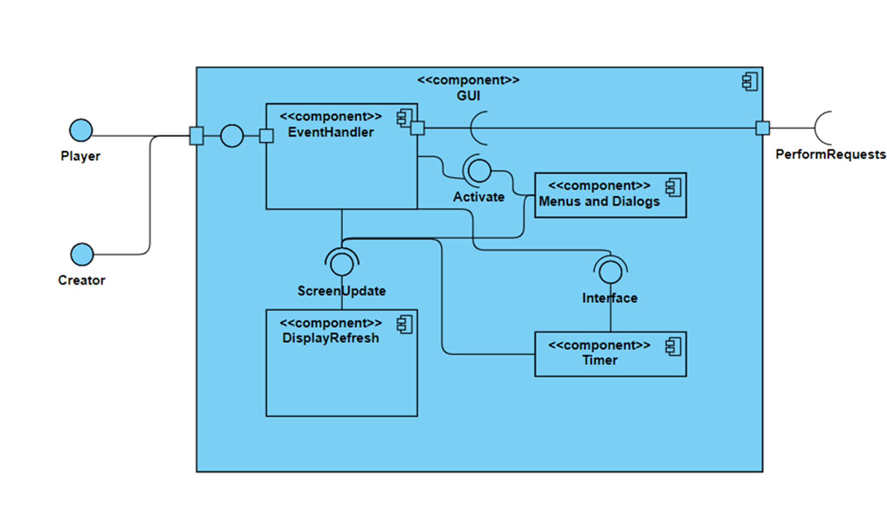
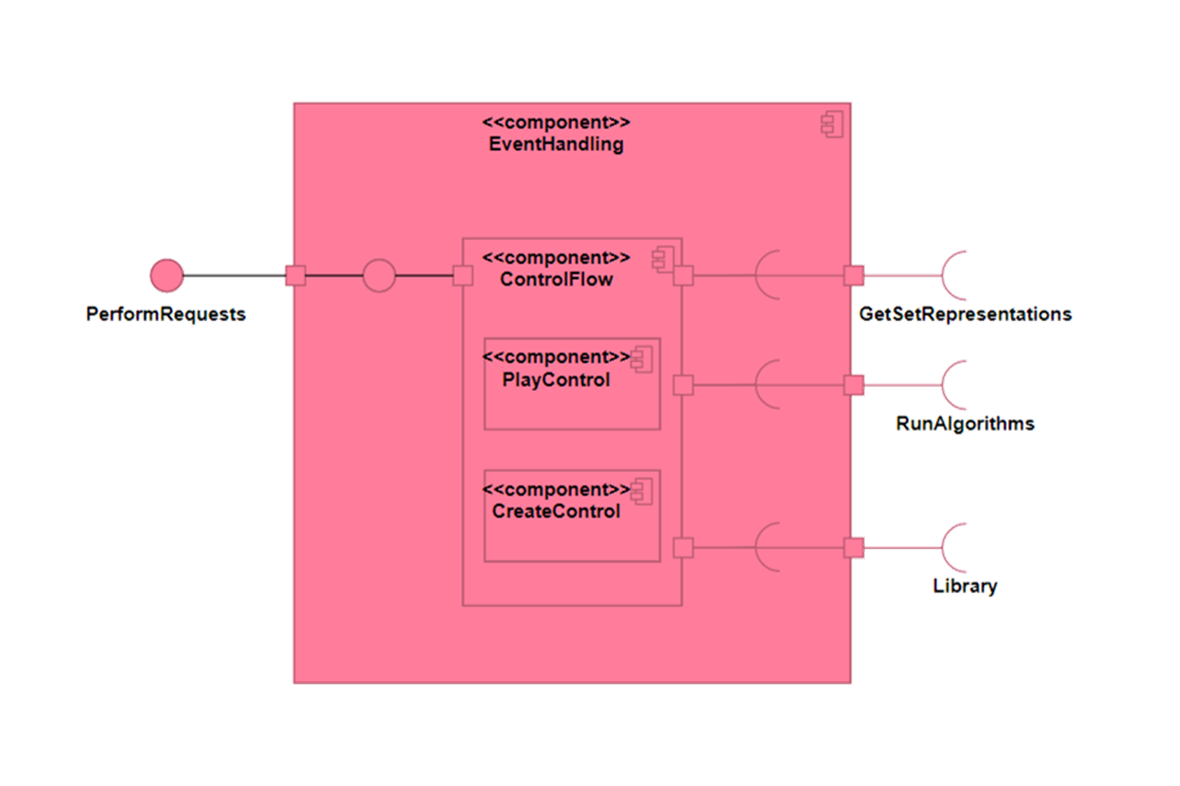
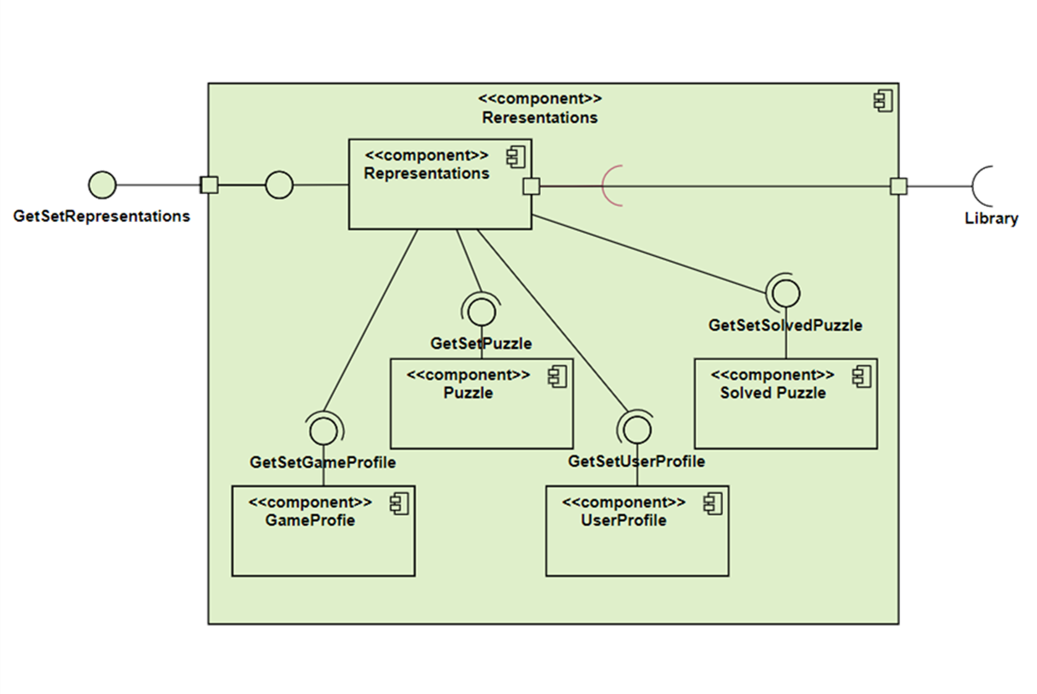
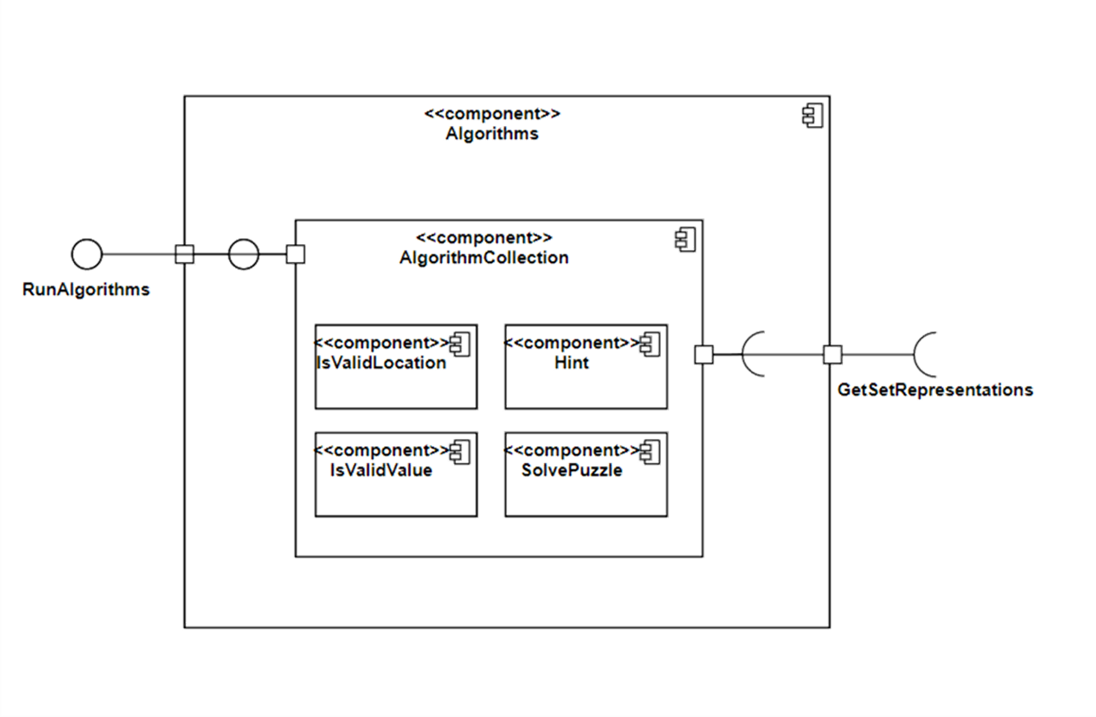
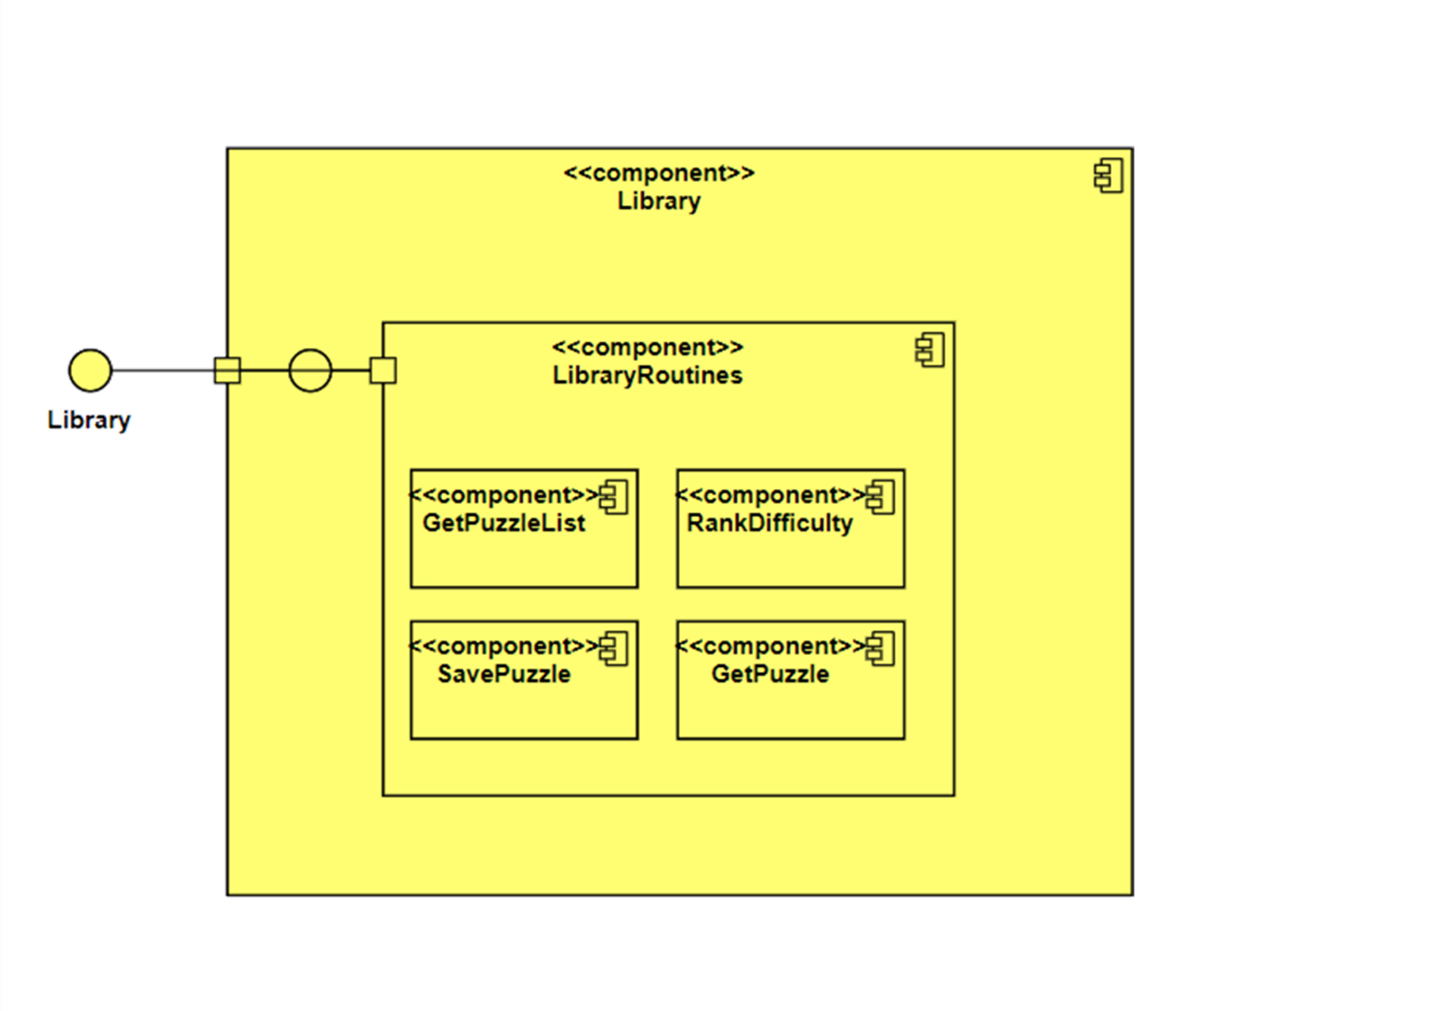

Slide 33
Component diagrams leading to system diagrams
File I/O
Swift <==> C++ bridge
System call
Python
JSON
Web Server
Python
MongoDB
iPhone app
Swift
Game engine
C++
Mobile app display with dynamic server running the app

Slide 34
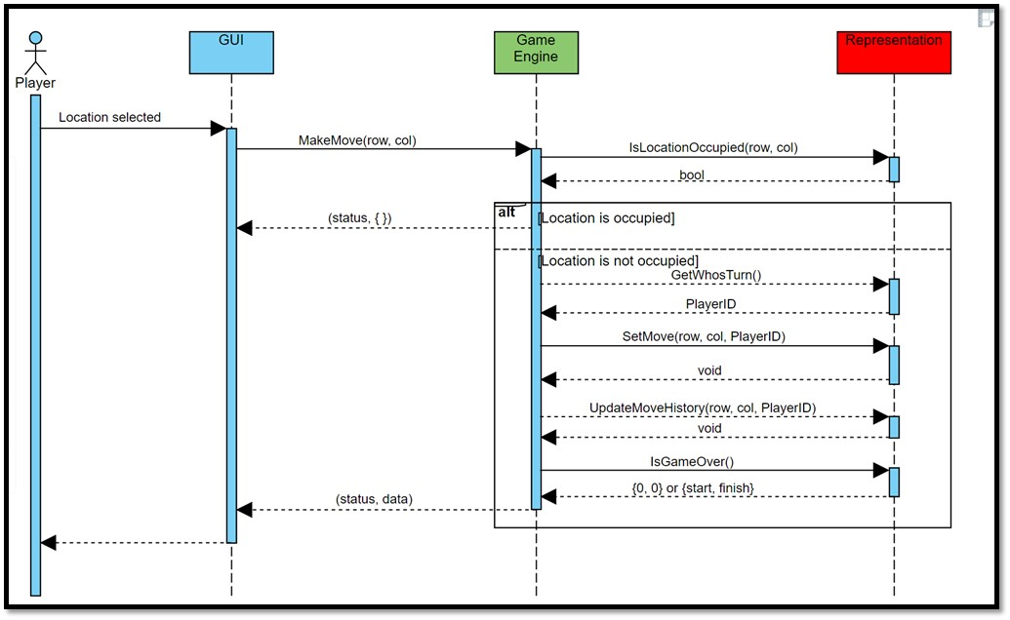
Sequence diagrams
Game Begins:
Draw board
Draw players
Create “Undo” button, faded out
Set turn to left-side player
Draw lights
Location selected:
If location selected not already occupied
Put current player’s representation at location selected
If move wins game
Show winning path
Prompt for another game …
Restart or exit
Make “Undo” not faded out
Change turn to other player
If location already selected notify player to select an empty location
Undo selected:
Remove last move from board
Change turn back to previous player
A Sequence Diagram:
Indicates what messages (function calls, method instantiations) are sent and when
Time progresses from top to bottom
Components involved are listed left to right
Messages are sent left to right among components in sequence

Slide 35
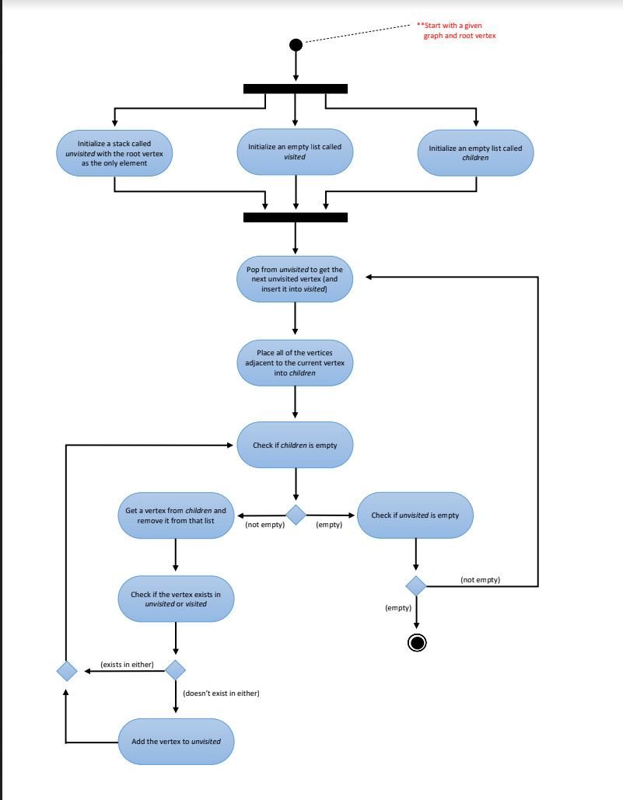
Activity Diagrams
Fancy flowchart
Displays the flow of activities involved in a single process
States
Describe what is being processed
Indicated by boxes with rounded corners
Swim lanes
Indicates which object is responsible for what activity
Branch
Transitions that branch
Indicated by a diamond
Fork
Transition forking into parallel activities
Indicated by solid bars
Start and End
Should be easy for a competent programmer to translate into code

Slide 36
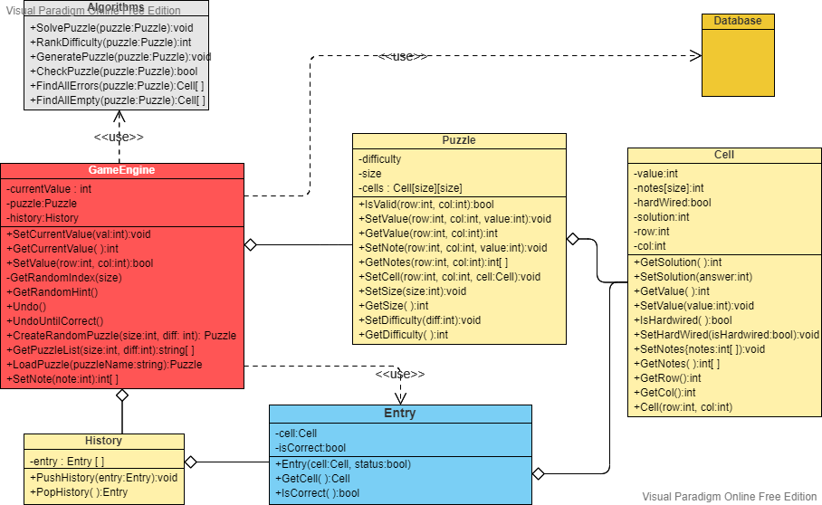
Class Diagrams
Give an overview of a system by showing its classes and the relationships among them.
Class diagrams are static
They display what interacts but not what happens when they do interact
Also shows attributes and operations of each class
Good way to describe the overall architecture of system components

Slide 37
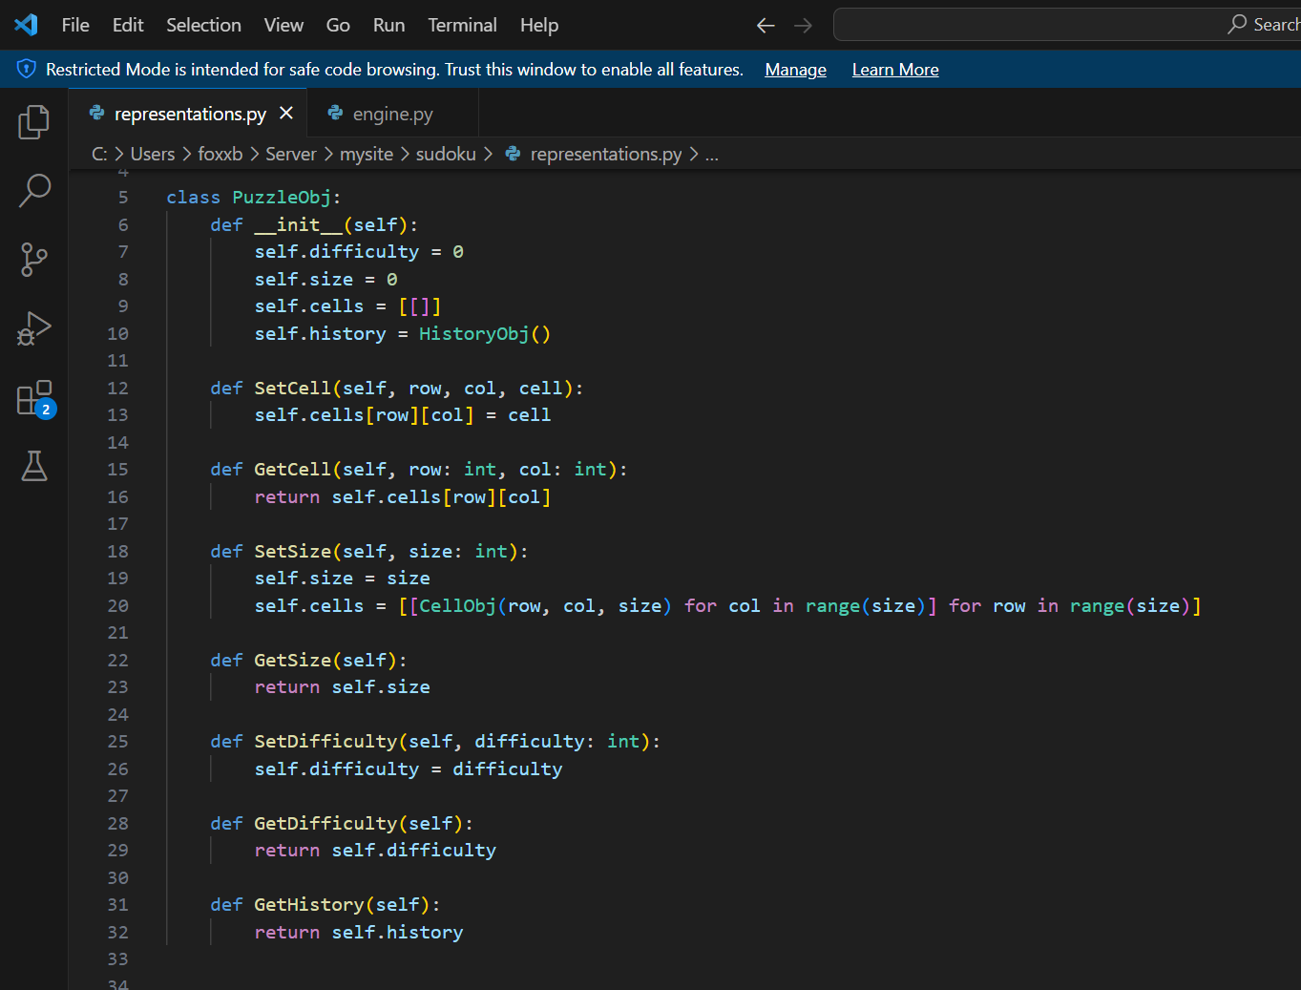

Slide 38
Core principles
(from chapter 6 in our book)

Slide 39
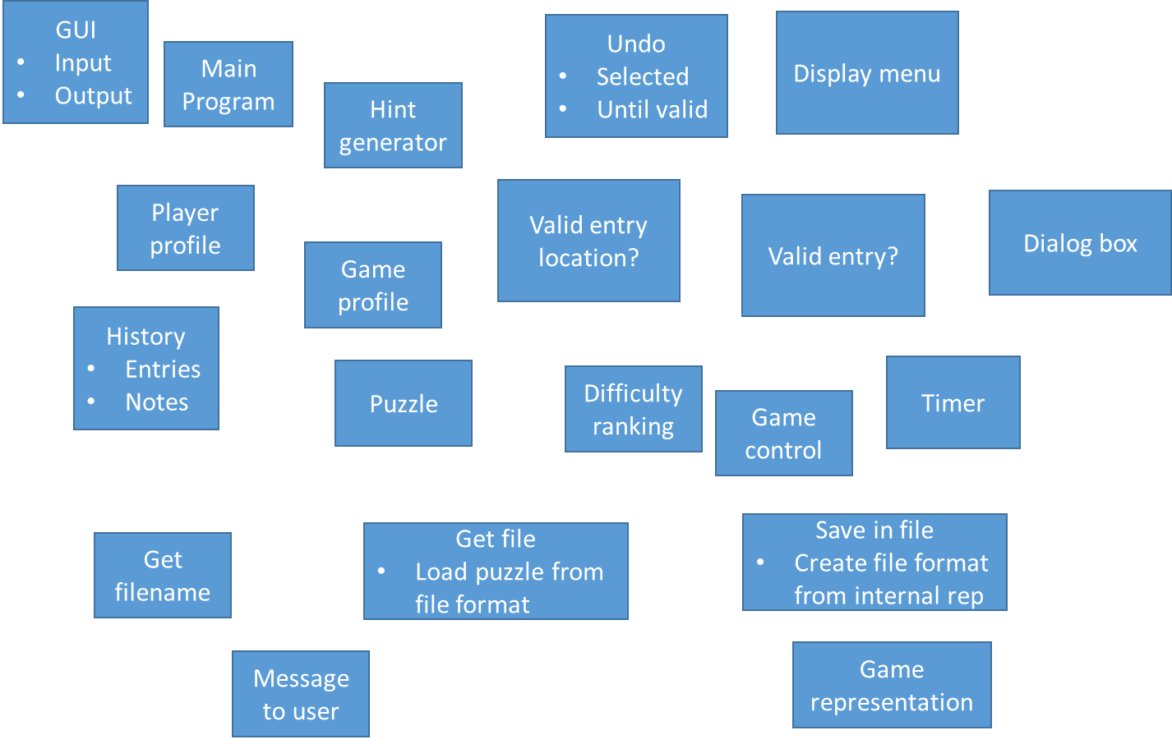
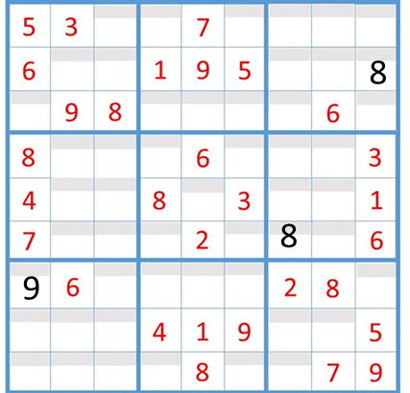
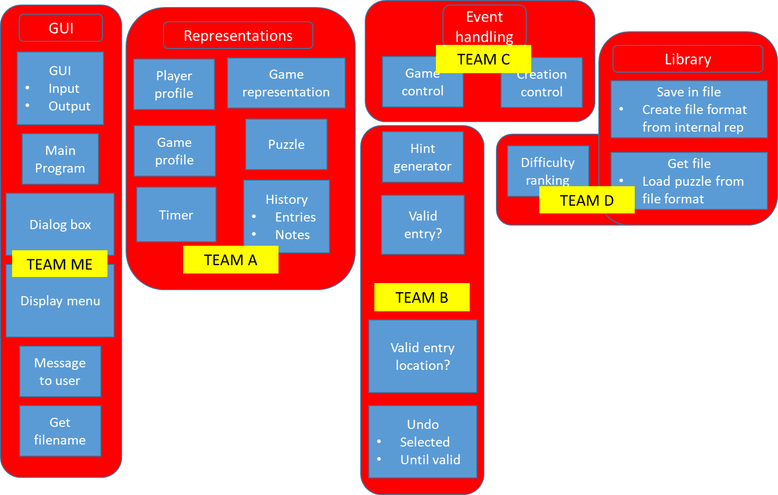
Core principles
Divide and conquer
Abstraction
3 4 7
A matrix of tiles with option of notes or values

Slide 40
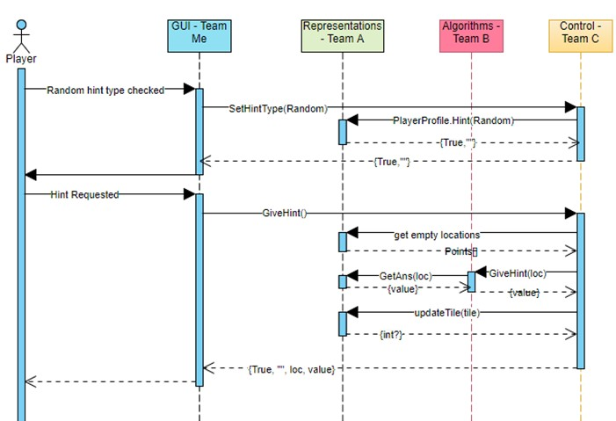
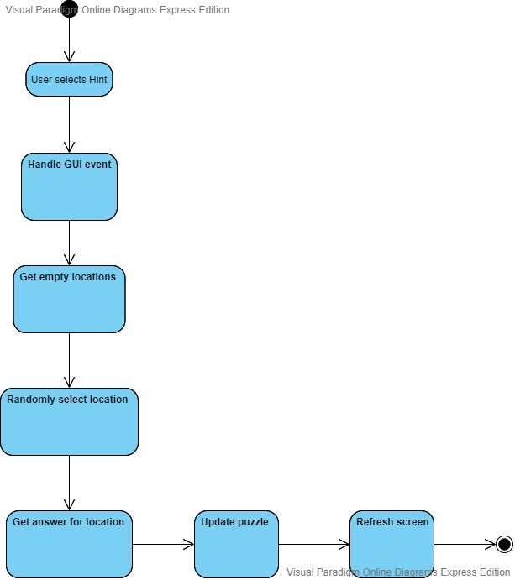
Core principles
Focus on the transfer of information
Build software that exhibits effective modularity
“Modularity must be effective. That is, each module should focus exclusively on one well-constrained aspect of the system—it should be cohesive in its function and/or constrained in the content it represents.”

Slide 41
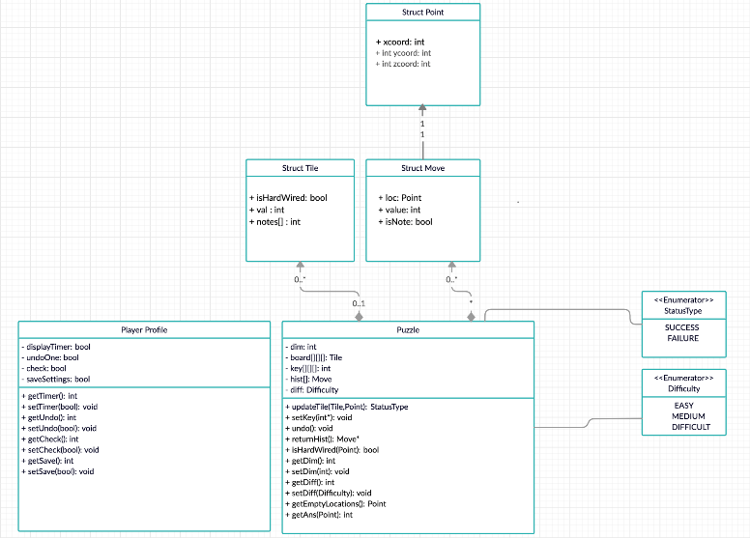
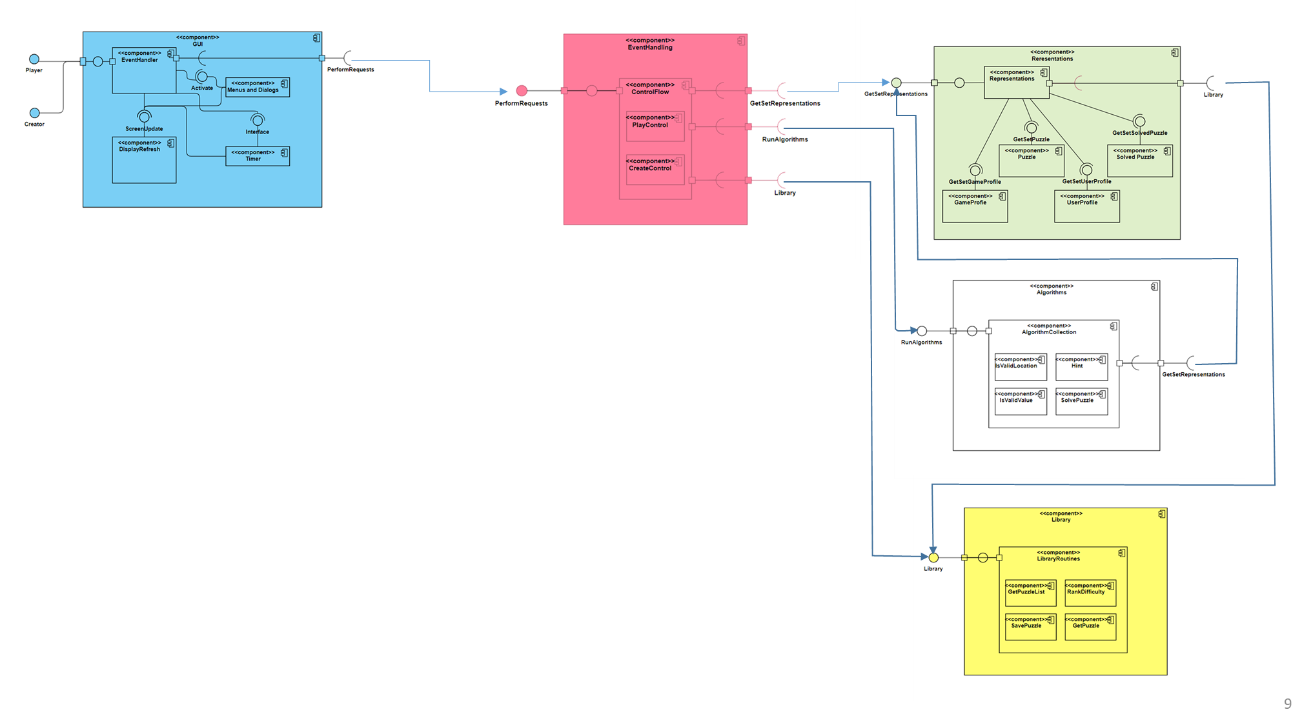

Core principles
Look for patterns, E.g.:
Undo
Undo until correct
Give hint at selected location
Give hint at a random location
User creates a puzzle
A puzzle from a library is loaded
Creating an answer key
Is a puzzle being created solvable?
Does a puzzle have a unique solution?
When possible, represent the problem and its solutions from a number of different perspectives

Slide 42
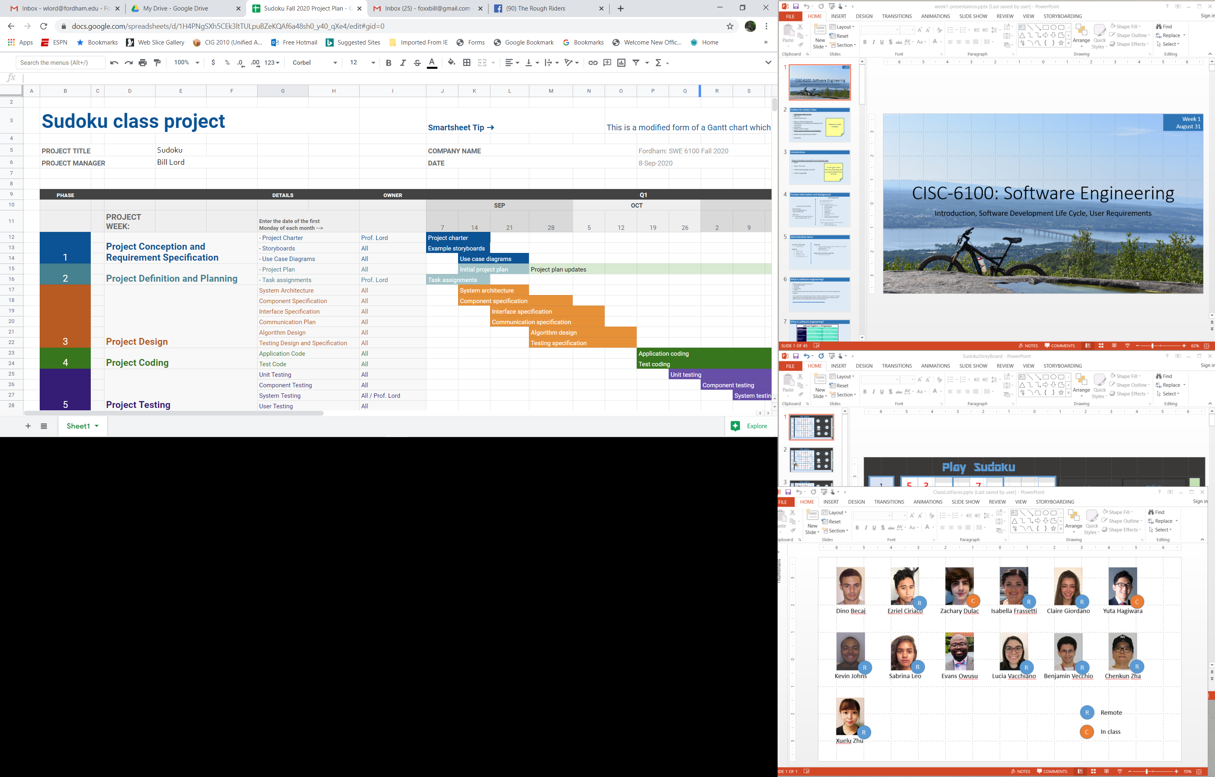
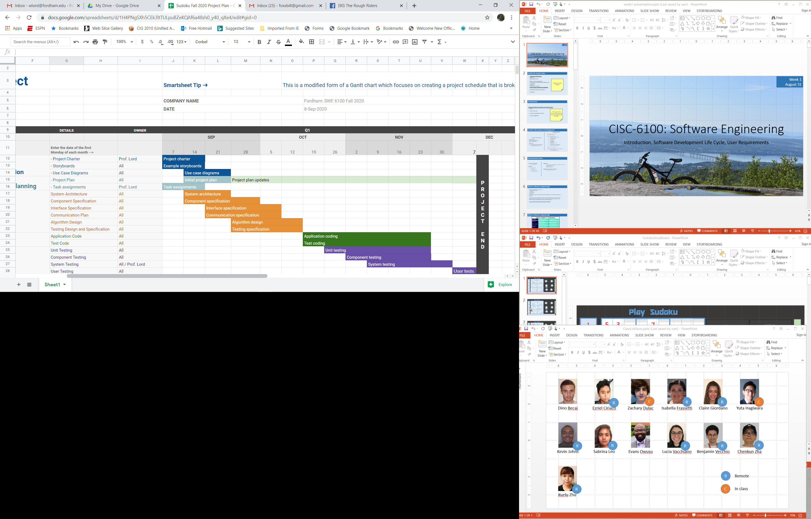
Core principles
Remember that someone will maintain the software
Adjust granularity as you define the plan/design

Slide 43
Core principles
Design of data is as important as design of processing

Slide 44
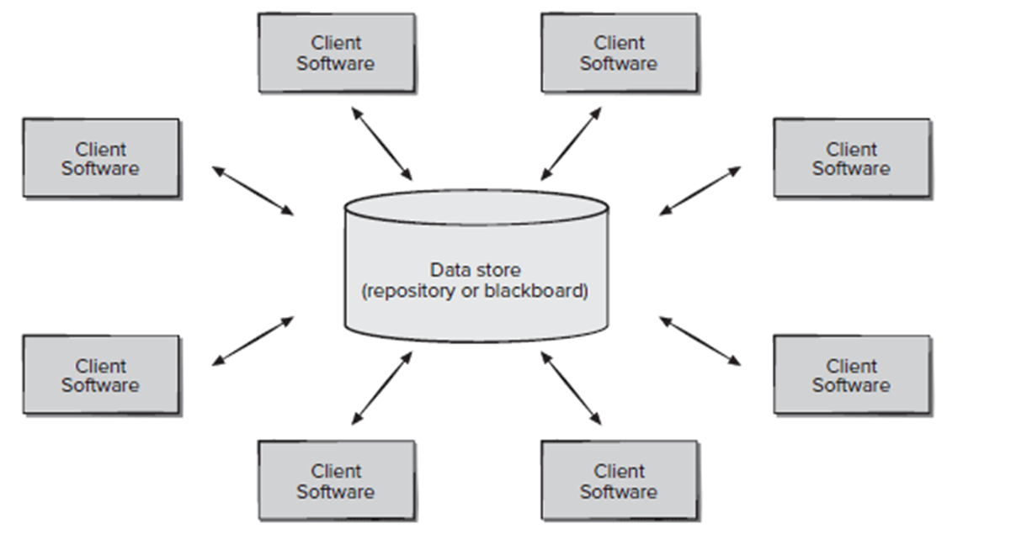
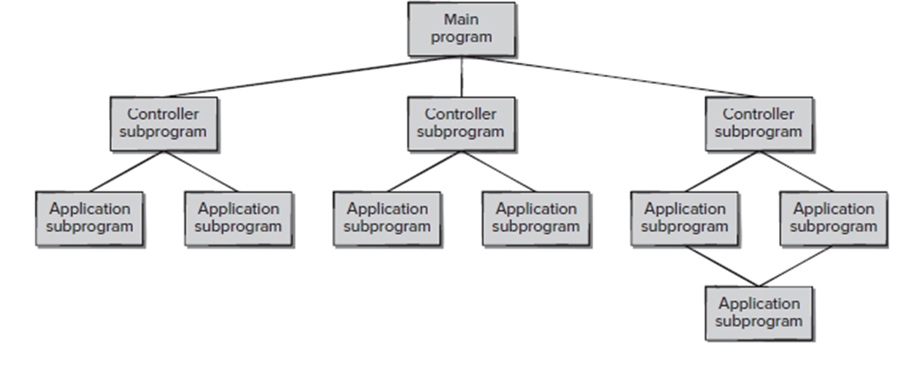
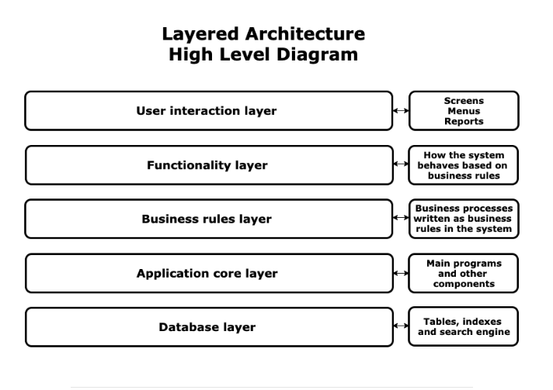
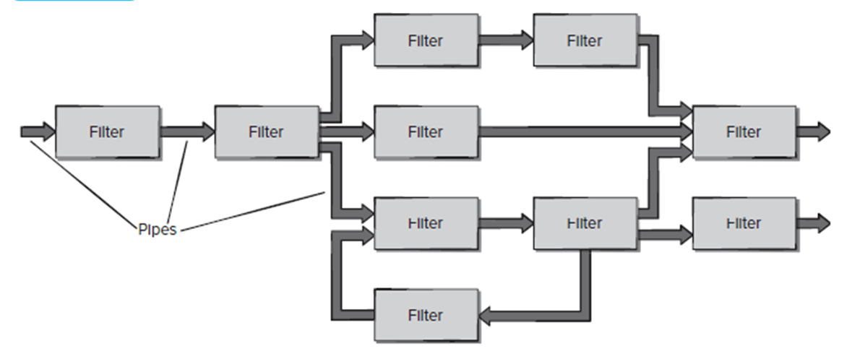
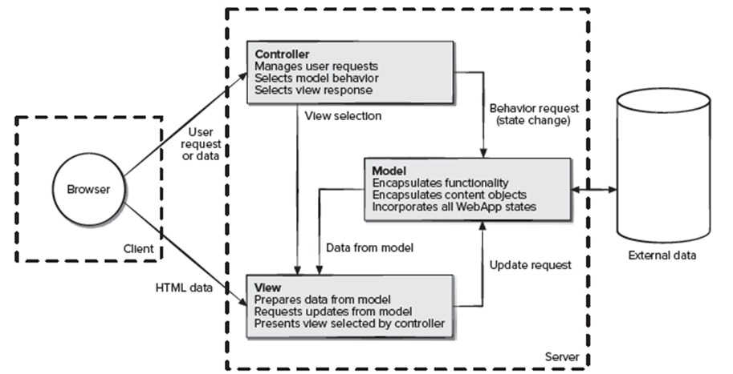
Software architecture refers to the fundamental structures of a software system and the discipline of creating such structures and systems. Each structure comprises software elements, relations among them, and properties of both elements and relations. https://en.wikipedia.org/wiki/Software_architecture

Slide 45
Homework for Week 9 (November 4th)
Status reports from teams:
Azerbaijan
Bro
C
A short verbal update on how your project is going. Please include:
What you’ve worked on in the past week
Unexpected difficulties and thoughts on mitigation
What’s gone well!
Your progress versus your plan, and any changes made to the plan
Next steps

Slide 46
Midterm overview and practice
Test will be a combination of closed book and open book. In the open book you may use any on-line resources except another human.
I’m hoping the average time to the test will be an hour, but you will have the full class
There will be many possible answers to most questions, I will accept any answer you can correctly justify
Questions will be primarily from material covered in class, but will likely include some short answer questions from the end of chapters of assigned readings
You will not be asked to create UML diagrams or programs from scratch, but may be asked to read, trace or modify them
Show your work

Slide 47
Midterm review
From Fall 2023
Question # Team name
1 Azerbaijan
2 Bro
3 C
4 D
5 Edamame
6 F

Slide 48

Review midterm
Questions 1-6 are closed book. Once you complete those questions, I suggest you take a picture of your answers to use as reference for question 7 which is open book. Before you start question 7 please hand in your answers for questions 1-6. Please put your name on any papers you hand in.
Background scenario for all questions:
In an initial meeting with a potential customer, you were told the following:
We would like for you to design and build a program to help high school students learn geometry. We will start simple and just implement triangles, but eventually add other polygons and circles. The program will start with an arbitrary triangle displayed on the screen. Students should then be able to iteratively indicate any of the following:
The length of an edge
The degrees or radians of a vertex
The sine, cosine, or tangent of an angle
As information is entered in, the program will update the look of the triangle to best reflect the known information, and label all known vertices and edges. When enough information is available to derive new information, that information will be also used to update the look of the triangle, and the newly derived information will be used to label the triangle along with a note about what theorems and calculations were used to derive it. This process will repeat until all edges and vertices are known.

Slide 49
Review midterm
Create a bullet list of all the known capabilities that the program must have. (10 points)
Create a bullet list of the known representations the program must have (10 points)
Create a bullet list of all the (potentially complex) processing the program must do (10 points)
List 3 clarifying questions you would ask in your meeting and state (1 sentence) why you would ask each question. (10 points)

Slide 50
Review midterm
For this question choose from the following UML diagram types (use each diagram type only once) In one to three sentences, explain your choice. (15 points)
Class diagram
Activity diagram
Use case diagram
Sequence diagram
Component diagram
Figuring out if the latest user entered information can be used to derive any additional information. Why?
Showing all the ways in which a user can interact with the program. Why?
Grouping similar capabilities, representations, and processing into logical entities. Why?
Showing high-level interactions among the major building blocks of the program. Why?
Showing the order in which high-level interactions would take place for a given user interaction. Why?

Slide 51
Review midterm
For this question choose from the following list of core design principles (use each core principle only once; not all will be used) Choose the design principle that best describes the reason behind the action described. In one to three sentences, explain your choice. (15 points)
Divide and conquer (Separation of concerns)
Abstraction
Focus on the transfer of information
Build software that exhibits effective modularity
Look for patterns
Represent problems and solutions from a number of different perspectives
Remember that someone will maintain the software
Adjust granularity as you define the plan/design
Design of data is as important as design of processing
You do a pencil and paper exercise to trace what happens when a user selects an edge and specifies that it is 10 units long.
Although you don’t implement it, you heavily document the code for how you see the eventual implementation of circles fitting in the current code.
You spend time on how you want triangles (or what is currently known about them) to be specified, independent of how you plan on storing them in memory.
In looking ahead at implementing circles and any polygons in addition to triangles you conclude that adding polygons should be easier than adding circles.

Slide 52
Review midterm
Describe in outline form the steps you would take to complete the design and implementation of the geometry assistant program described at the beginning of this exam. You do not need to draw diagrams but should explain what types of diagrams you might use and when. For each diagram mentioned, list the high-level content that it would include. Use references back to previous steps to describe iterative processes. Your answer should be one to two pages (no more). (30 points)

Slide 53
Midterm review
From Fall 2022
Question # Team name
7 (from 2021) Azerbaijan
1 Bro
2 C
3 D
4 Edmame
5 F

Slide 54
Review midterm
CISC-6100
Software Engineering
Midterm -- Fall 2022
Background scenario for questions all questions:
You and your college roommate decide you want to put together your two skill sets and your shared love of tea to create a startup company selling iced tea. Your roommate is a Health and Nutrition major whose name is Han. You are you, a Software Engineer. Your idea for market differentiation is that you will use feedback from social media to drive a machine learning algorithm that will periodically tweak your various iced tea products. You’ve decided to name your company MajoriTea.
Your description of how your factory will work follows: A conveyor will carry empty cans to a filling station where the currently selected type of iced tea (unsweetened, sweetened, or diet) made from the most up-to-date recipe will fill the can and top it. From there it will go to a labelling station where labels are printed with the type of type of tea, ingredients, nutritional information, and artwork. Finally, the finished product will go to an area where it can be manually boxed. A console provides an interface for an operator to specify which type of tea is to be produced, a button to start the operation, a button to stop the operation, and a system status display. The fill station should be thought of as a black box, but with APIs that can be used to control the amount of all the possible ingredients that go into a specific type of tea. The machine learning algorithm, also to be thought of as a black box, uses these APIs to tweak the tea recipe based on data collected from social media which is stored in a database. The filling station and the labelling station both have sensors to detect ‘out of resources’ and can force a stop of the operation.
From the description of the MajoriTea factory above list all the major components required to implement the factory/system described. (10 points)

Slide 55
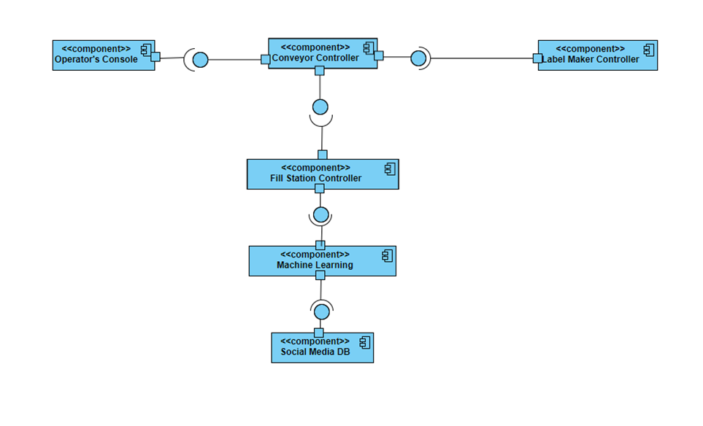
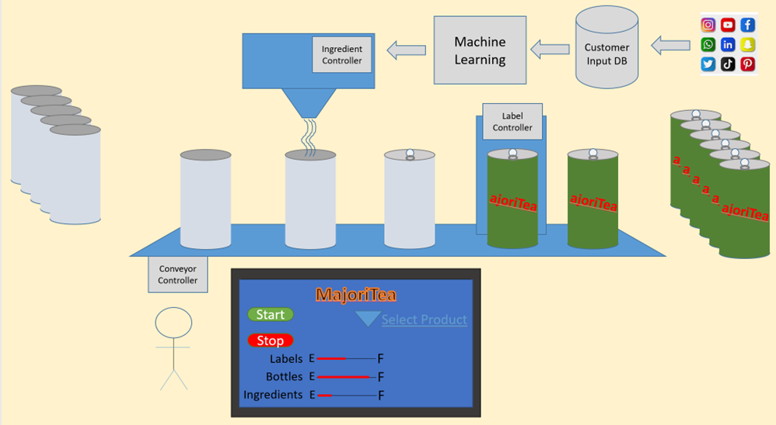
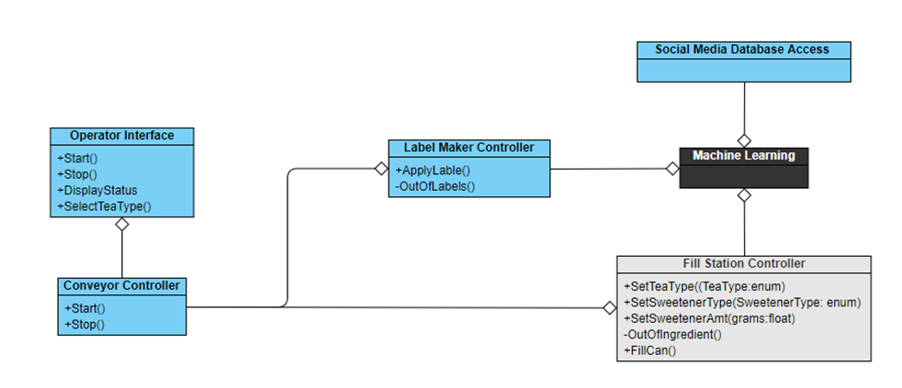
2. Which of the following diagrams would be the best to show your overall system plan to your business partner/roommate, Han? Why? (20 points)
a.
b.
c.

Slide 56
3. What type of UML diagram might be best suited to show how the Machine Learning module could work? Why? (10 points)
4. At least 2 requirements discussed in the project description that are missing from the design specification diagrams:
Creating labels based on current tea type and recipe
Label maker and fill station signaling resource status back to the operator interface and out-of-resources to the conveyor controller
a. Explain how design omission can become more costly as progress on the project goes forward. (3-7 sentences) (20 points)
b. Given your explanation in a, which of the two missing requirements would be the more costly to fix as time goes on? Why? (10 points)
c. Given the ‘core principles’ of design (week 5 slides starting on slide 30, or from the book) and the design omission of not including the out-of-resource exception to the conveyor controller, which core principle, if followed better, would have caught that omission? Which type of UML diagram is best for your chosen core principle. (10 points)
d. Choose either of the two omissions and describe which phase (or type) of testing would have caught the omission. Why/how? (10 points)

Slide 57
5. Which process model would you follow for this project? Why? (10 points)

Slide 58
Midterm review
From Fall 2021

Slide 59
Review midterm
All questions on the exam will relate to the following scenario:
Your team has been asked to design and implement a video game for pool (billiards). The application will allow for selecting from a menu of different pool games and number of teams/players. For each player’s turn a representation of the cue stick can be manipulated to strike the cue ball in a desired direction and speed. The result of this will be a graphical representation of ball movement, including balls hitting other balls, balls hitting walls, and balls going into pockets. The program will update a display of scores after each shot and declare a winner when according to the rules of the game being played the game is over.
What could be the main modules or high-level components of a solution? Provide a sentence or two description of what the module would do/include. (10 points)
GUI component: Where the menu component, pool games component, and event handler component would live. Where the player and creator first interact, from there a request is made to the event handling component (User input and graphical/animated output)
Event Handling Component: that gets the representations and runs the algorithms necessary to play. This can make requests to the representation, algorithms, and library components
Representation component - where the cue stick, cue ball, pool table, team/player profiles, scoreboard would live. Makes requests to library
Algorithms component - algorithms to calculate the ball’s movement when hit with the stick, when it hits a wall, another ball, algorithms to calculate the score and declare a winner. Algorithms makes requests to representations (Physics engine and game engine)
Library component: Has the variety of pool games available, Saves the game

Slide 60
Review midterm
2. From the scenario above and the further information presented in parts a-e identify a ‘core principle’ from the list below that best describes the principle being used. Explain your choice in 1-3 sentences. (30 points)
• Divide and conquer (Separation of concerns)
• Abstraction
• Focus on transfer of information
• Build software that exhibits effective modularity
• Look for patterns
• Represent problems and solutions from a number of different perspectives
• Remember that someone will maintain the software
a. During brainstorming the team identifies that calculating a ball’s movement after it has been struck, detecting collisions, and reacting to a ball being sunk (falls into a pocket) are all part of what happens during a player’s turn, but are different enough activities that individual components should be created for each of them.
Divide and Conquer: This specific scenario speaks to the core principle divide and conquer or “separation of concerns” because the development team determined that these functionalities should remain apart. (The team has determined that there would be minimal overlap or reuse of code among the components so could easily be done separately.)
During the same brainstorming session as in ‘a.’ the team decides that determining a ball’s path after it collides with another ball, after it hits a wall, and after it hits a pocket are all similar enough to be parts of the same component.
Look for patterns: If a pattern is recurrent, the solution can be effectively reused to save time and resources that would otherwise be spent rehashing the same solutions. Reducing the pattern to one solution is parsimonious efficient.

Slide 61
Review midterm
2. From the scenario above and the further information presented in parts a-e identify a ‘core principle’ from the list below that best describes the principle being used. Explain your choice in 1-3 sentences. (30 points)
• Divide and conquer (Separation of concerns)
• Abstraction
• Focus on transfer of information
• Build software that exhibits effective modularity
• Look for patterns
• Represent problems and solutions from a number of different perspectives
• Remember that someone will maintain the software
Part way through the implementation an original design decision is found to be incomplete. The project leader then assigns a team member to update the original design documents to reflect the change to be made.
In this particular scenario, the team decided to document and write the breakthroughs the development team has realized, after the implementation started, project leader makes the decision to update the design documents. This action will justify the reasoning behind the approach and will provide a clear approach to the next company/team who will eventually continue developing/maintaining the project. Therefore, the project leader focused on "remember that someone will maintain the software" by making this decision and made sure that the information and reasoning is not lost in the process.

Slide 62
Review midterm
2. From the scenario above and the further information presented in parts a-e identify a ‘core principle’ from the list below that best describes the principle being used. Explain your choice in 1-3 sentences. (30 points)
• Divide and conquer (Separation of concerns)
• Abstraction
• Focus on transfer of information
• Build software that exhibits effective modularity
• Look for patterns
• Represent problems and solutions from a number of different perspectives
• Remember that someone will maintain the software
UML use case diagrams were used to show how the end result would be interacted with from a user’s point of view. Sequence diagrams were used to show the primary call sequence among the identified modules. Activity diagrams were used to develop algorithms for determining a ball’s motion once struck.
The core principle here is representing the problem and solutions from several different perspectives. These diagrams all represent how the application will be used and how it works at different levels. (These diagrams each use the best practices that describe different aspects of an overall design.)
After determining the attributes required to model a pool ball, the team spends considerable time determining what information about each ball will be required for a component to calculate its new location at a specified time after it has been hit, what information will be required to detect collisions, and what information is needed to update scores.
The core principle here is focusing on the transfer of information. The team is trying to determine what information is needed for their different components to work as they expect.

Slide 63
Review midterm
For each of the descriptions presented in parts a-e identify a UML diagram from the list below that could be used in the design process to represent the problem. Explain your choice in 1-3 sentences. (30 points)
Use case diagram
Activity diagram
Component diagram
Sequence diagram
Class diagram
State diagram
Deployment diagram
Describing all the information, access, and processing that should be implemented for pool balls, cue stick, pool table.
To model classes, including their attributes, operating and their relationships and associations with other classes, UML provides class diagrams. Class diagram will provide a static/structural view of the system and include all the necessary information of each component.
Showing all the interactions the game players can have with the game.
In this case, we are summarizing the detail of the system users and the users’ interaction with the system a use case diagram would facilitate this design process best. Due to the requirement to display users’ interaction with the system through various interactions, the use case diagram is the most suitable.

Slide 64
Review midterm
For each of the descriptions presented in parts a-e identify a UML diagram from the list below that could be used in the design process to represent the problem. Explain your choice in 1-3 sentences. (30 points)
Use case diagram
Activity diagram
Component diagram
Sequence diagram
Class diagram
State diagram
Deployment diagram
Describing how collision detection should be determined.
Activity diagram because they display the flow of activities in a single process which collision detection would be. (Best choice for initial design and documentation of algorithms.)
Identifying at a high-level which modules identified in question one connect and communicate.
Component diagram because they achieve higher levels of abstraction and focus on the transfer of information which matches with “connect and communicate” in the description.

Slide 65
Review midterm
For each of the descriptions presented in parts a-e identify a UML diagram from the list below that could be used in the design process to represent the problem. Explain your choice in 1-3 sentences. (30 points)
Use case diagram
Activity diagram
Component diagram
Sequence diagram
Class diagram
State diagram
Deployment diagram
Showing the steps involved after a user strikes the cue ball with the cue stick
A sequence diagram is a great for this particular task. Since the action is "strike cue ball with a cue stick", a sequence diagram can show all the steps involved between different layers of components correctly and accurately in the order they should be used and the information that should flow among them.

Slide 66
Review midterm
Each of the following questions are based primarily from reading assignments. (30 points)
In the first release of the pool game the company wants players to be able to play the pool game known as 8 ball and in the second release wants players to also be able to play 9 ball. Additionally, for the first release they are not requiring that a ball’s spin is taken into account, but in the second release spin should be used in calculating a ball’s motion. Which of these two plans might be able to be developed using the prototype process model (Section 2.5.2) and which would be better suited to the spiral model (Section 2.5.3)? Back up your answer with 1-3 sentences.
Prototype process model – Developing a 9-ball game after designing and developing an 8-ball game would not require any major core changes except for a different encoding of the rules of the game. No new core functionality needs to be added. Because of this, the 8-ball game could be developed using a prototype process model and then the 9-ball game could be developed by re-using the 8-ball code in another prototype process.
Spiral process model – A key philosophy of the spiral process model is: “The spiral model demands a direct consideration of technical risks at all stages of the project and, if properly applied, should reduce risks before they become problematic.” Not considering spin early on could result in major changes later on to representations of balls, algorithms to calculate a ball’s path when struck, and algorithms to determine what happens when balls collide.

Slide 67
Review midterm
Each of the following questions are based primarily from reading assignments. (30 points)
For the pool game(s) development which of the 8 principles that guide process (Section 6.1.1) seems the most important to you? Why, in 1-3 sentences?
Build an effective team.
Structuring an effective team to bring the right people together is critical in starting any development project. Every team member must be well accounted for to meet specific design requirements as such must have an adequate reason for being a part of the team. For example, requirements may warrant having such team members from C-Management, Marketing, Design, Legal, Field Experts as well as Software Engineers and Developers.
Graphics/animation
Physics/mathematics
Full stack development?
Database

Slide 68
Review midterm
Each of the following questions are based primarily from reading assignments. (30 points)
Whereas storyboards are great for showing a customer how you envision the realization of their requirements looking, use cases (Section 7.4) first need to be determined and then used to inform the design of the storyboards. Describe the topic of three use cases that should be developed and why; one sentence each.
Use Case #1:
Name: Player hits a ball with a stick
Actor: User
Preconditions: User is currently playing a game
Event Flow: User drags the stick in opposite direction of the ball & user moves stick forward and strikes the cue ball.
Use Case #2:
Name: Player wins the game
Actor: User
Preconditions: User is currently playing a game & only the 8 ball is left for the player
Event Flow: User moves the cue and hits a ball & 8 ball goes into called pocket.
Use Case #3:
Name: Player puts black into hole
Actor: User
Preconditions: User is currently playing a game.
Event Flow: User moves the cue, user hits a ball and the ball is black, and user is given a penalty for making an invalid move.

Slide 69
Review midterm
Each of the following questions are based primarily from reading assignments. (30 points)
Identifying analysis classes (Section 8.3.1) shows how to use the nouns in use cases to make an initial list of potential classes. Identify the nouns in the initial scenario of this exam and indicate which should lead to a class being developed.
Your team has been asked to design and implement a video game for pool (billiards). The application will allow for selecting from a menu of different pool games and number of teams/players. For each player’s turn a representation of the cue stick can be manipulated to strike the cue ball in a desired direction and speed. The result of this will be a graphical representation of ball movement, including balls hitting other balls, balls hitting walls, and balls going into pockets. The program will update a display of scores after each shot and declare a winner when according to the rules of the game being played the game is over.
Nouns leading to potential classes: game, games, player(s), cue stick, cue ball, ball, balls, walls, pockets, score

Slide 70
Review midterm
Each of the following questions are based primarily from reading assignments. (30 points)
For each of the four types of testing shown in figure 19.1 (Section 19.1.3) describe a hypothetical test that would be set up for our pool scenario; one sentence each.
Unit testing- Testing the code that determines the ball’s path after a collision by testing a good input, an invalid input, and an edge case
Integration testing- Testing what happens during a players turn, hitting the ball with the cue stick, where the ball goes, what it hits, if it makes it in the pocket depending on if the hit is accurate enough all need to be tested
Validation testing- Testing the requirements in this case we could check if scores and winners are properly declared by playing the game and seeing if the output is accurate.
System testing- Test by actually using the game and acting as a player. Check everything. If a new game can start, if teams can be created, if turns are taken correctly, does the ball move accurately compared to where the cue stick is aiming, does the ball move accurately when it hits another object, are points given correctly, is a winner declared accurately at the end of the game.

Slide 71
Midterm review
From Fall 2020

Slide 72
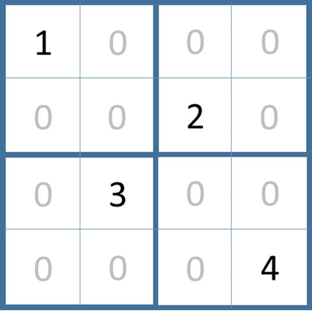
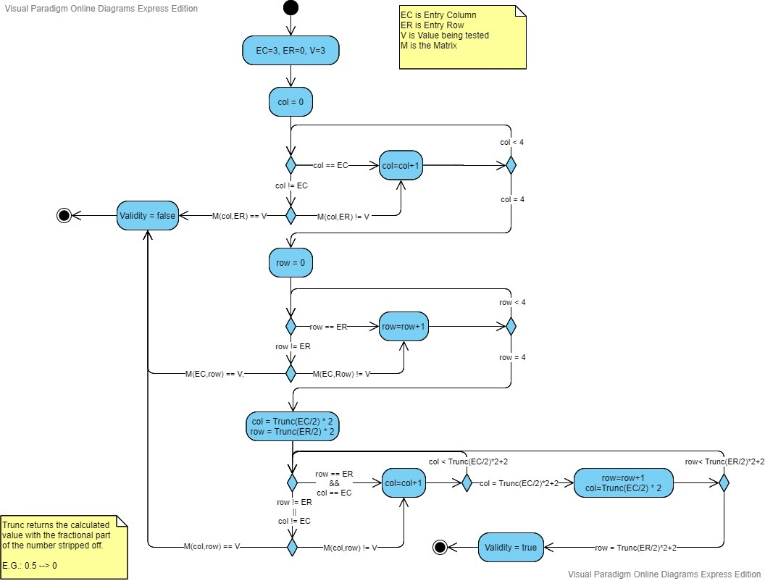
Review midterm
1. For the matrix ‘M’ on the left, use the activity diagram below to derive the value of ‘Validity’ upon termination. Remember to show your work.
EC=1, ER=0, V=2
EC=1, ER=3, V=2
EC=2, ER=3, V=3

Slide 73
Review midterm
2. Assuming the Activity Diagram in question 1 has been turned into a function called CheckValidity with EC, ER, and Val as passed parameters to the function
a. Give examples of three function calls that would be good candidates for use in unit testing. Explain your reasoning.
1 – bool b = CheckValidity(3, 0, 1) // Test to see if a match in a row is found
2 – bool b = CheckValidity(0, 3, 1) // Test to see if a match in a column is found
3 – bool b = CheckValidity(2, 2, 4) // Test to see if a match in the same quadrant is found
These three test represent the three possible ways the function should return ‘false’. Additionally, each one is testing a value to be placed in a different quadrant. Many other correct answers are possible…
b. Testing the coded function with (0, 0, 2) will return ‘true’. Does this expose a flaw in the function? Make an argument for why it doesn’t.
No, not in the implementation of the function. An implementation if done correctly follows the activity diagram. Now, if this was part of a Sudoku game (however, this is never stated), one could correctly argue that the activity diagram has a flaw.
c. Testing the coded function with (1, 1, 5) will return ‘true’. Does this expose a flaw in the function? Make an argument for why it doesn’t. Similar logic as above.

Slide 74
Review midterm
3. For each of the scenarios presented in parts a-e identify a ‘core principle’ from the list below that best describes the principle being used. Explain your choice in 1-3 sentences.
Divide and conquer (Separation of concerns)
Abstraction
Focus on transfer of information
Build software that exhibits effective modularity
Look for patterns
Represent problems and solutions from a number of different perspectives
Remember that someone will maintain the software
Adjust granularity as you define the plan/design
Design of data is as important as design of processing
a. As part of testing her path planning algorithm Karen identifies a design problem which she fixes in the code. She then goes back to the design documents to update them with the change.
- Remember that someone will maintain the software. Especially in large projects (but even in small) it is important to keep the documentation and the code in sync. Designs should always be completing with the thought that someone else will be either writing or maintaining the code. Any new people brought onto the project will typically start by reading over high-level documentation and working their way through lower-levels of documentation before starting with the code.

Slide 75
Review midterm
b. Nick, a mechanical engineer, is developing a computer model of the cardiopulmonary system (body systems involved in circulating oxygenated blood). At the highest levels the system describes pumps, filters, pipes, etc. Deeper into the code system characteristics are described in terms of resistance, capacitance, current, etc. At the lowest levels values being modelled are calculated using partial differential equations.
- Abstraction. Each level of detail in the code design uses an abstraction (a way of thinking about or visualizing the problem) to come up with clear ways (for domain experts) to model or create representations in the software.
c. Xinxin is designing an application to display context sensitive information for making medical decisions. To do this she (and the system) require a knowledge of recommended guidelines for specific conditions, which encapsulate the order in which tasks are to be carried out, algorithms to be run to derive required information, and data that has to be accessed.
- Represent problems and solutions from a number of different perspectives. (There were multiple applicable choices for this question.) An argument for the answer given is that different types of UML diagrams could be used to represent the design of each of the major tasks: sequence diagram, activity diagram, class diagram.

Slide 76
Review midterm
d. Hans was brought onto a team developing computer interpretable guidelines because of a tool he designed to graphically input and represent complex data structures and/or class definitions and then automatically generate code to implement them.
- Design of data is as important as design of processing. Creating and using a high-level tool to graphically visualize the class data and methods to be used provides a way for multiple team members to create and work with large and complex data structures. Being able to generate code from these diagrams helps keep design and code in sync.
e. Erina is responsible for data mining data that originates from multiple sources, each of which may have different representations. She has broken the problem down into multiple steps: data acquisition, data translation/normalization, data merging, data cleansing, data analysis, and reporting.
- Divide and conquer (Separation of concerns). Each of the listed steps can be implemented without knowledge of how the other steps work. The important connection among them is data transfer as one step is completed and needs to pass on its processed data to the next step.

Slide 77
Review midterm
4. For each of the descriptions presented in parts a-e identify a UML diagram from the list below that could be used in the design process to represent the problem. Explain your choice in 1-3 sentences.
Use case diagram
Activity diagram
Component diagram
Sequence diagram
Class diagram
State diagram
a. Tracing an event that starts with sensor activating, through a collection of modules to process the event, culminating in an alarm being triggered.
- Sequence diagram. The problem description doesn’t describe any decision making, just a list of modules that will be used in a specific order, and with information that will have to be pass knowledge of the event (and more) along the path.
b. Representing a heuristic that iterates over multiple decision points made by three different components.
- Activity diagram. More specifically an activity diagram with ‘swim lanes.’ Whenever decisions and loops are used, an activity diagram will most likely be the best representation tool. Algorithms/heuristics are typically best represented using activity diagrams.

Slide 78
Review midterm
c. Identifying which modules communicate with other modules and the nature of the communication.
- Component diagram. Because the order of the communication is not specified, and we are dealing with modules (higher-level components) a component diagram will best capture identifying the modules and their relations.
d. Showing how a real-life entity should be modelled.
- Class diagram. Classes are used to specify the data and computation specifications of what will be instantiated as object. Objects are often considered computer implemented versions of real-life objects.
e. Depicting actors and their intended interactions with a system.
- Use case diagram. Use case diagrams are for showing how actors (users or devices) interact with a system. These interactions should include what the actor expects from the system including what happens when an expected interaction goes wrong.

Slide 79
Project and midterm question time
…

